Slide 1



ResolveIT Smart Grievance & Feedback Management System - Public Transport Services
Presented by
Sumayya Tarannum

Slide 2

Abstract
ResolveIT is a digital grievance and feedback management system for public transport services. It allows passengers to register complaints, track resolution status, and provide feedback. The system improves transparency, reduces manual processes, and enhances service quality through structured backend architecture and database management.The system allows passengers to register grievances, track complaint status, and provide feedback regarding transport services.
01

Slide 3
Existing System
Manual complaint registration (offline / paper-based)
No centralized grievance management system
Lack of transparency in complaint resolution
Passengers cannot track complaint status and no structured feedback
Proposed System
Digital grievance registration platform
Centralized complaint and feedback management system
Real-time grievance tracking for passengers
Role-based access for Admin and Passenger and structured feedbacks.
02

Slide 4
Problem Statements
Lack of centralized grievance management system
Manual and time-consuming complaint handling
No real-time tracking for passengers
Delayed resolution from authorities
Poor transparency in complaint processing
Absence of structured feedback mechanism
03

Slide 5
Tools and Technologies
Frontend Technologies ORM Tool
HTML JPA(Java Persistence API)
CSS Hibernate
React.js
JavaScript
Backend Technology Development Tools
Spring Boot (Java Framework) VS Code/IntelliJ IDEA
RESTful APIs Postman (API Testing)
Git(Version Control)
Database
MySQL
04

Slide 6
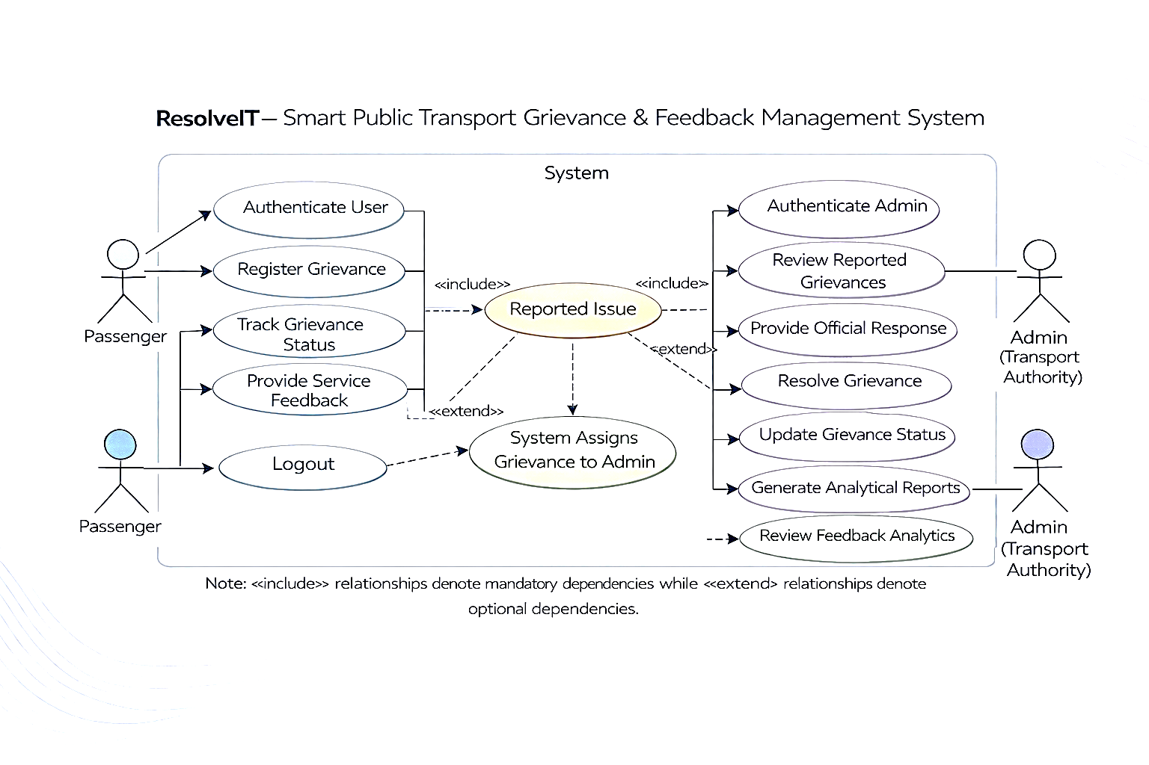
Use Case Diagram
05

Slide 7
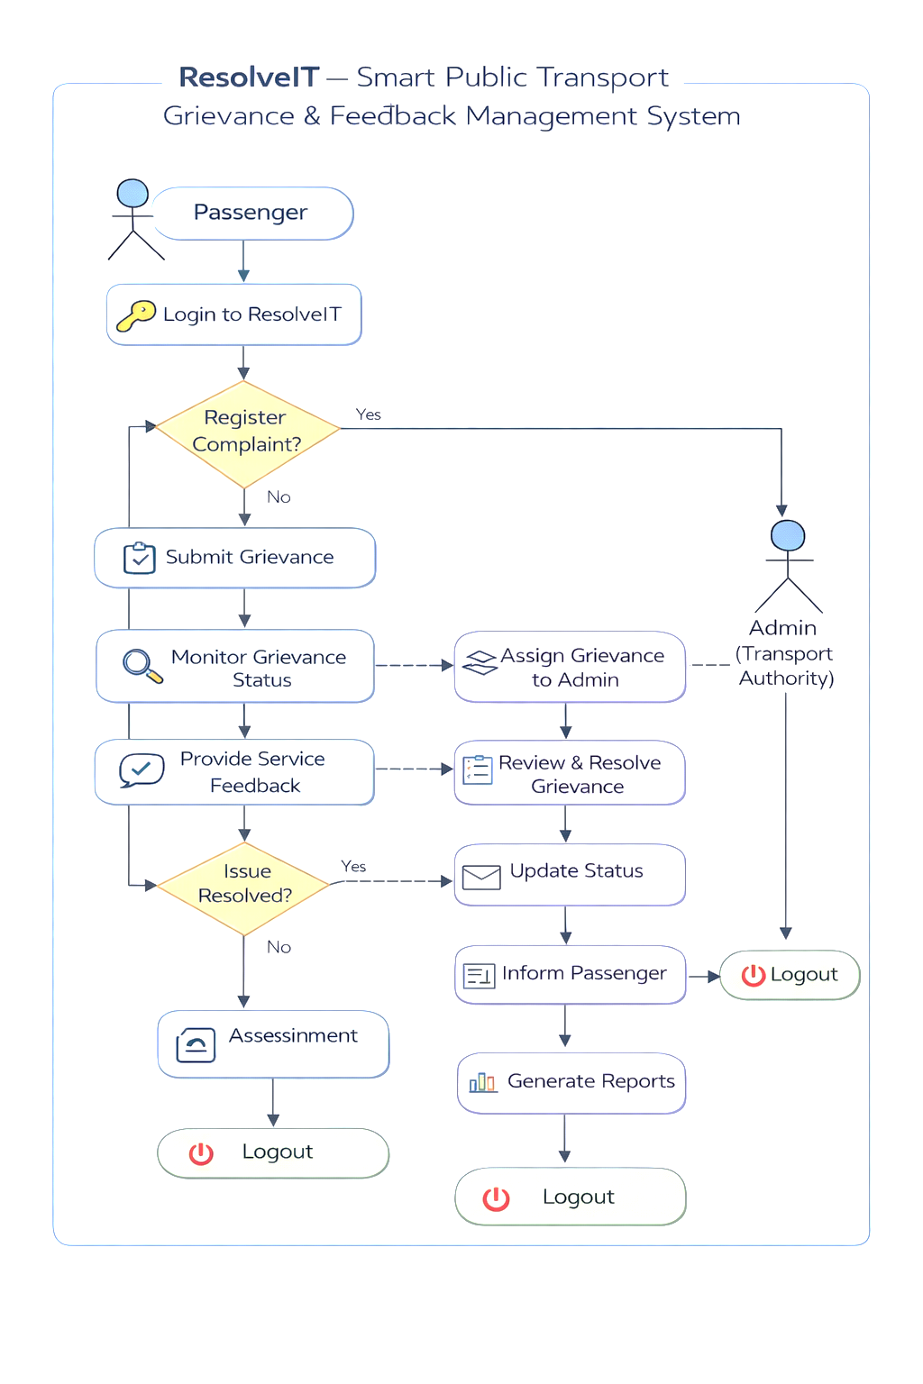
Workflow Diagram
06

Slide 8
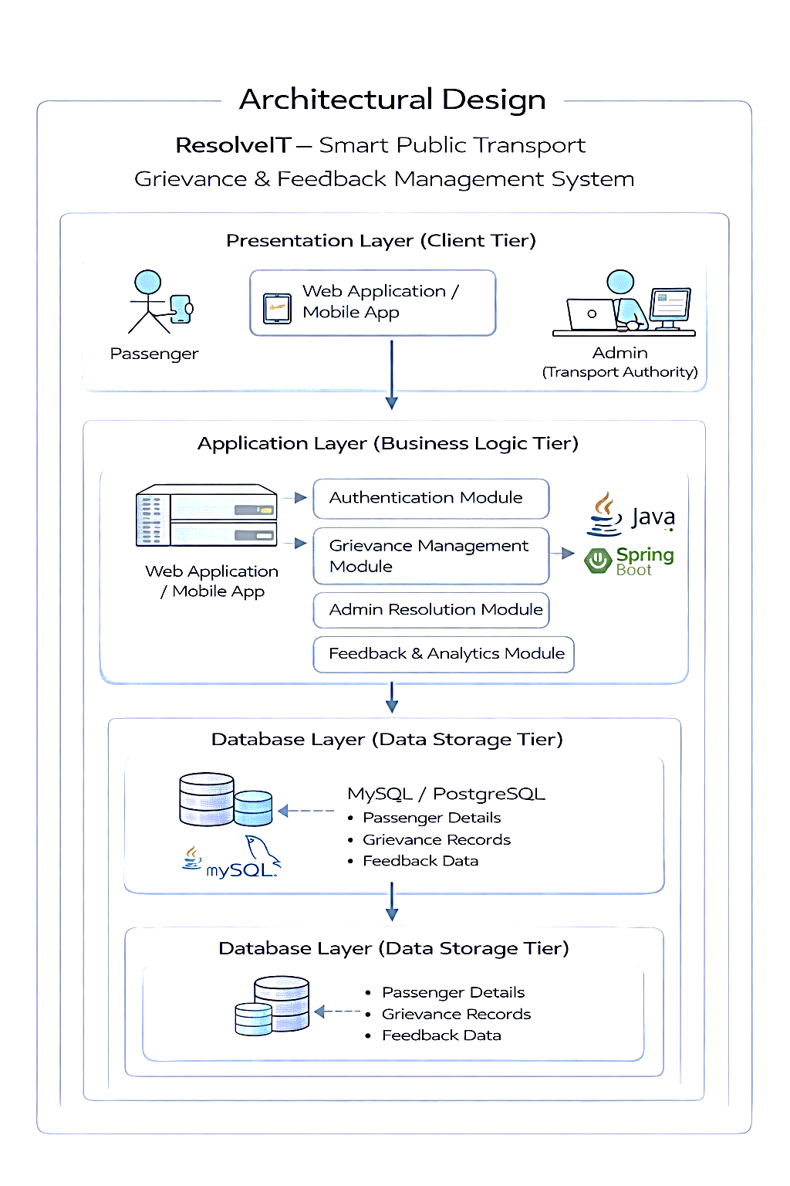
System Architecture Design
07

Slide 9
Benefits Challenges
Faster complaint resolution Handling multiple users at the same time
Real-time status tracking Managing server performance under load
Improved transparency Handling network or internet issues
Centralized data management Implementing secure authentication
Quick feedback collection Ensuring instant data synchronization
08

Slide 10
Modules
Authentication Module
Complaint Management Module
Admin Management Module
Feedback Management Module
Reporting & Analytics Module
09

Slide 11
Current Implementation Status
Login module completed
Complaint registration completed
Database integration done
Admin module in progress
Future Enhancement
AI-based complaint classification
Email/SMS notification
Analytics dashboard
10

Slide 12
THANK YOU

